Slide 1


Spring 2021
SKKU Biostats and Big data
CHOONG-WAN WOO | COCOAN lab | http://cocoanlab.github.io

Slide 2
GBME Probability and Statistics
Lecture 20
Lecture 20
Paired t-test
CHOONG-WAN WOO | COCOAN lab | http://cocoanlab.github.io

Slide 3
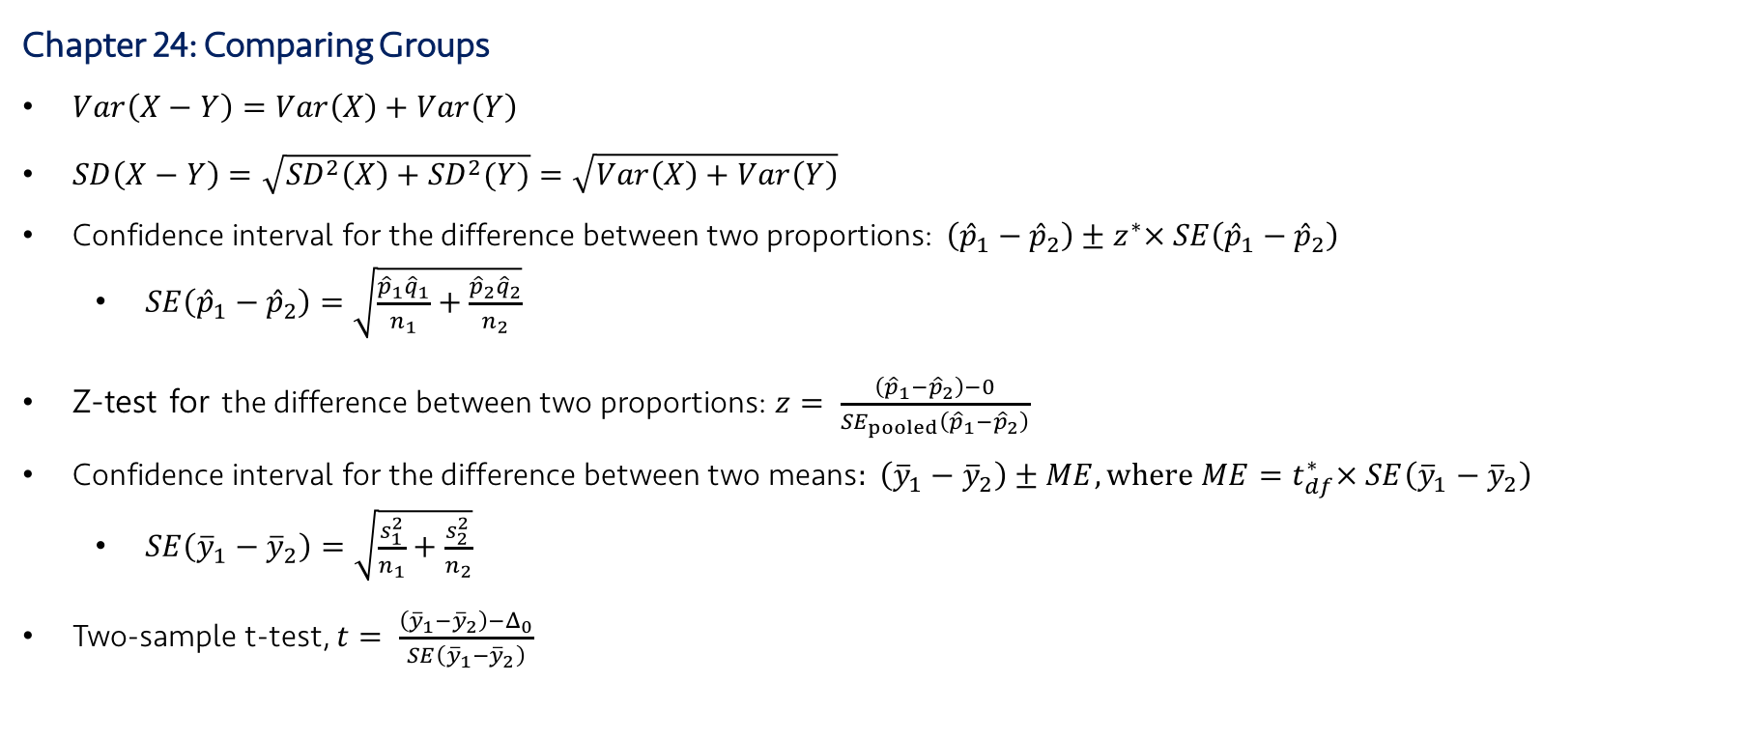
Lecture 20
Review: Key Points
Chapter 24: Comparing Groups
$Var\left(X−Y\right)=Var\left(X\right)+Var\left(Y\right)$
$SD\left(X−Y\right)=\sqrt{{SD}^{2}\left(X\right)+{SD}^{2}(Y)}=\sqrt{Var\left(X\right)+Var\left(Y\right)}$
Confidence interval for the difference between two proportions: $\left({\hat{p}}_{1}−{\hat{p}}_{2}\right)±z^{∗}× SE\left({\hat{p}}_{1}−{\hat{p}}_{2}\right)$
$SE\left({\hat{p}}_{1}−{\hat{p}}_{2}\right)=\sqrt{\frac{{\hat{p}}_{1}{\hat{q}}_{1}}{n_{1}}+\frac{{\hat{p}}_{2}{\hat{q}}_{2}}{n_{2}}}$
Z-test for the difference between two proportions: $z= \frac{\left({\hat{p}}_{1}−{\hat{p}}_{2}\right)−0}{{SE}_{pooled}\left({\hat{p}}_{1}−{\hat{p}}_{2}\right)}$
$\text{Confidence} \text{interval} \text{for} \text{the} \text{difference} \text{between} \text{two} \text{means}: \left({\overline{y}}_{1}−{\overline{y}}_{2}\right)±ME, where ME=t_{df}^{∗}× SE\left({\overline{y}}_{1}−{\overline{y}}_{2}\right)$
$SE\left({\overline{y}}_{1}−{\overline{y}}_{2}\right)=\sqrt{\frac{s_{1}^{2}}{n_{1}}+\frac{s_{2}^{2}}{n_{2}}}$
Two-sample t-test, $t= \frac{\left({\overline{y}}_{1}−{\overline{y}}_{2}\right)−Δ_{0}}{SE\left({\overline{y}}_{1}−{\overline{y}}_{2}\right)}$
CHOONG-WAN WOO | COCOAN lab | http://cocoanlab.github.io

Slide 4





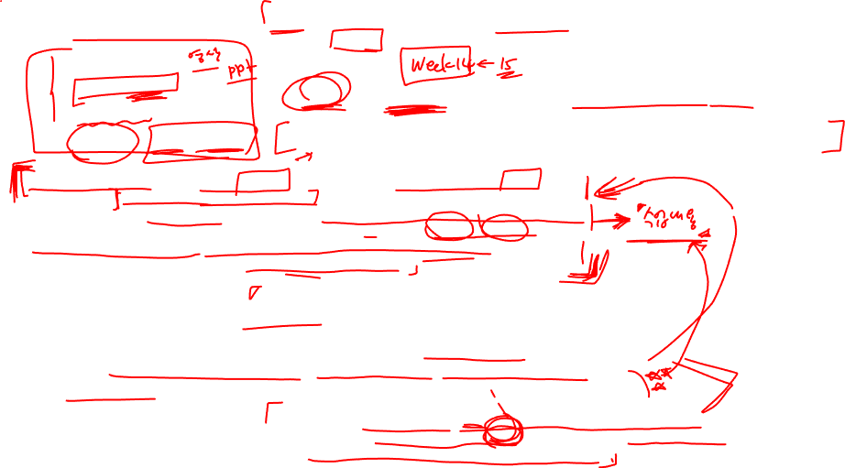
Lecture 20
Final survey results
No video editing
Online (report)
Week 14-15
소수의견: 단답형, 문제풀이
CHOONG-WAN WOO | COCOAN lab | http://cocoanlab.github.io

Slide 5
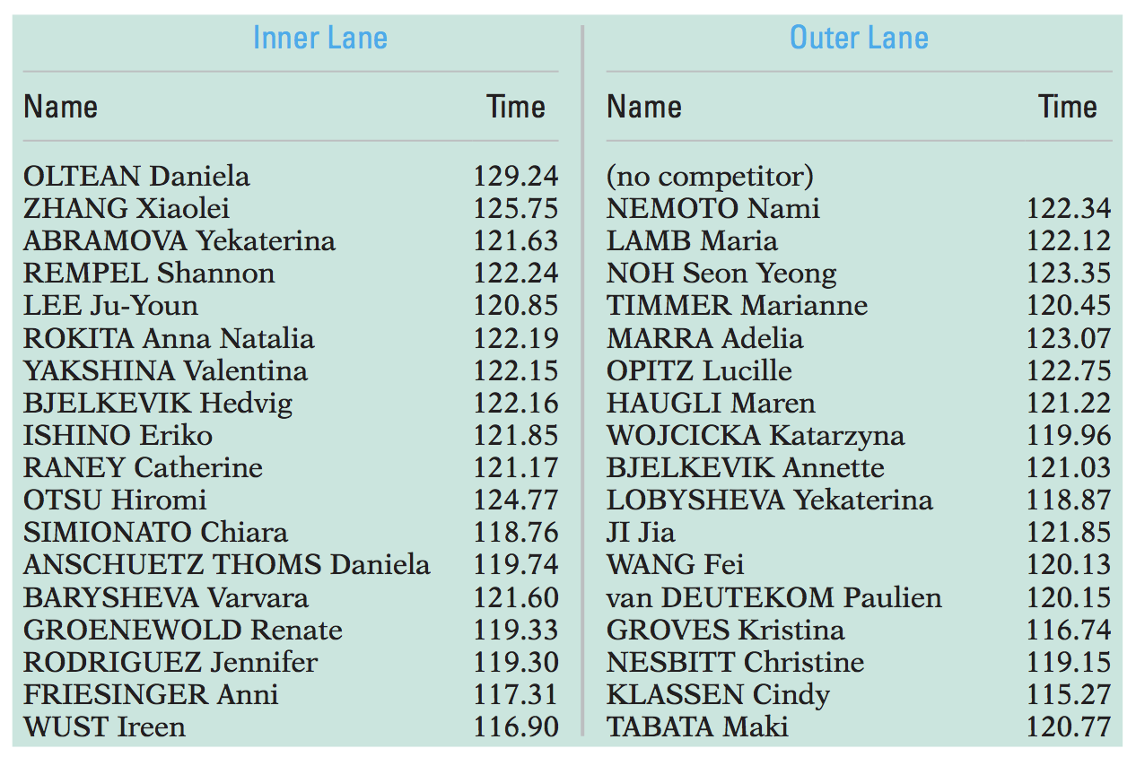
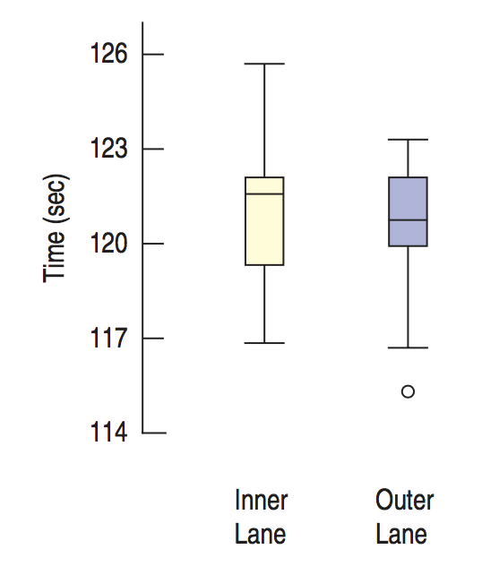
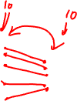
Lecture 20
Paired data
The example from the textbook: Speed-skating
Inner lane vs. outer lane
Question: Is there a difference between two lanes?
CHOONG-WAN WOO | COCOAN lab | http://cocoanlab.github.io

Slide 6
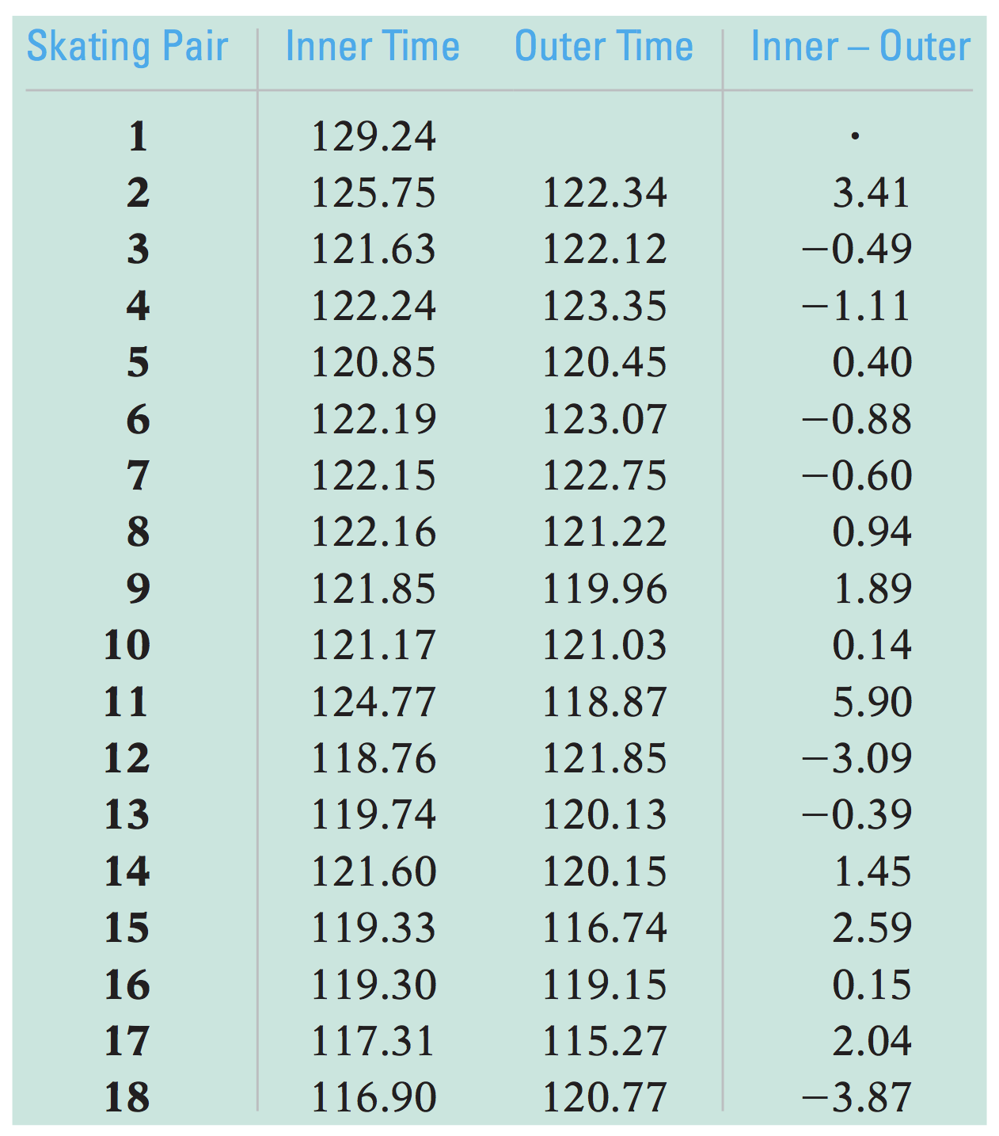
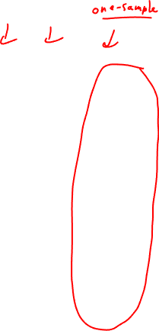
Lecture 20
Paired t-test
Two-sample t-test?
NO. The races are run in pairs, so the columns are not independent.
Instead, we should focus on the difference between each pair.
It’s not a problem, paired data provides an opportunity!
We need to take advantage of the paired data structure.
“Paired” t-test:
Use pairwise differences!
Ignore original two columns
One-sample t-test on the pairwise differences
CHOONG-WAN WOO | COCOAN lab | http://cocoanlab.github.io

Slide 7
Lecture 20
Assumptions and conditions
Paired data assumption
You should not use methods for paired data on independent data.
Or methods for independent data (e.g., two-sample t-test) should not be used on paired data.
Independence assumption
The differences for pairs should be independent of each other.
Conditions
Randomization condition
10% condition
Normal population assumption
The population of differences should follows a Normal model.
Each group doesn’t need to follow a Normal model.
CHOONG-WAN WOO | COCOAN lab | http://cocoanlab.github.io

Slide 8
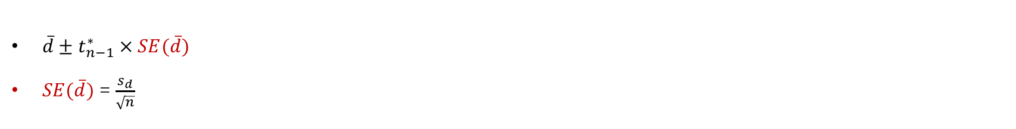
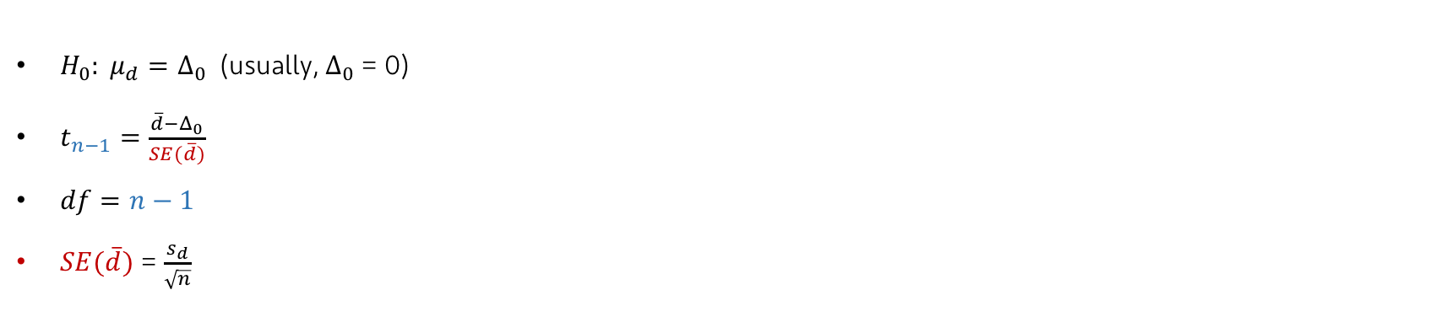
Lecture 20
Steps of paired t-test
$H_{0}: μ_{d}=Δ_{0}$ (usually, $Δ_{0}$ = 0)
$t_{n−1}=\frac{\overline{d}−Δ_{0}}{SE(\overline{d})}$
$df=n−1$
$SE(\overline{d})$ = $\frac{s_{d}}{\sqrt{n}}$
Confidence intervals for matched pairs
$\overline{d}±t_{n−1}^{∗} × SE(\overline{d})$
$SE(\overline{d})$ = $\frac{s_{d}}{\sqrt{n}}$
CHOONG-WAN WOO | COCOAN lab | http://cocoanlab.github.io

Slide 9
Lecture 20
Quiz 20-1
https://forms.gle/Bv8dkGXtSceDHK478
CHOONG-WAN WOO | COCOAN lab | http://cocoanlab.github.io

Slide 10
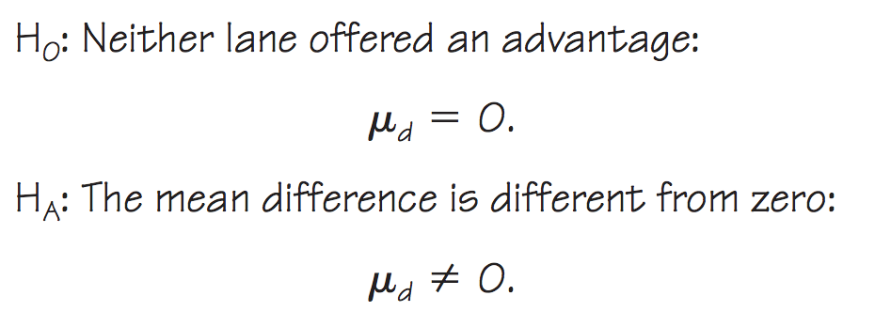
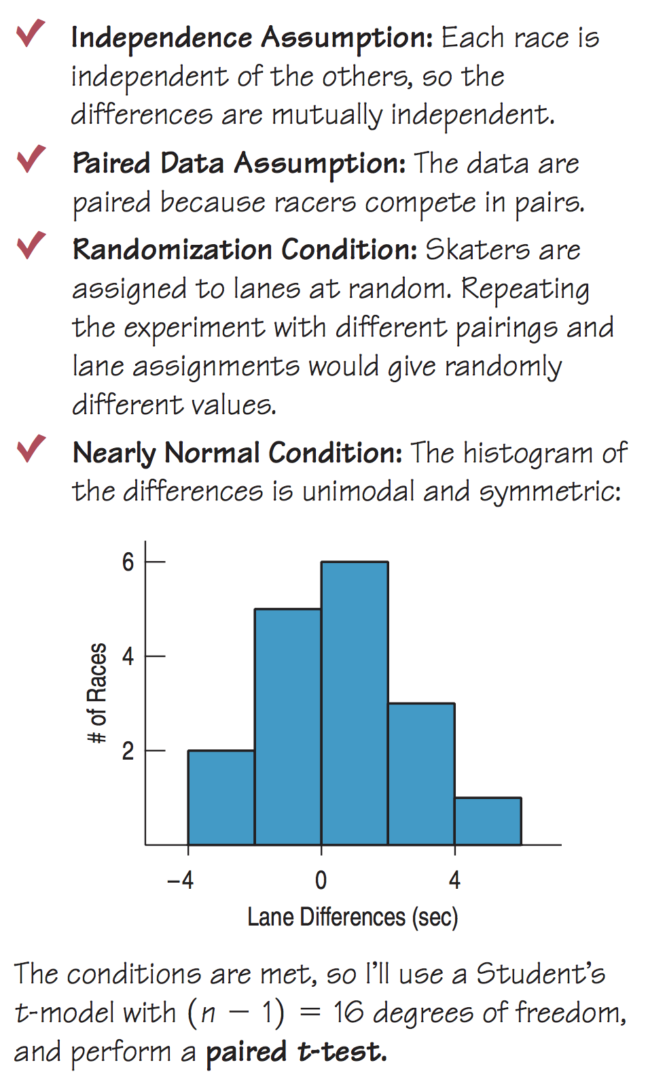
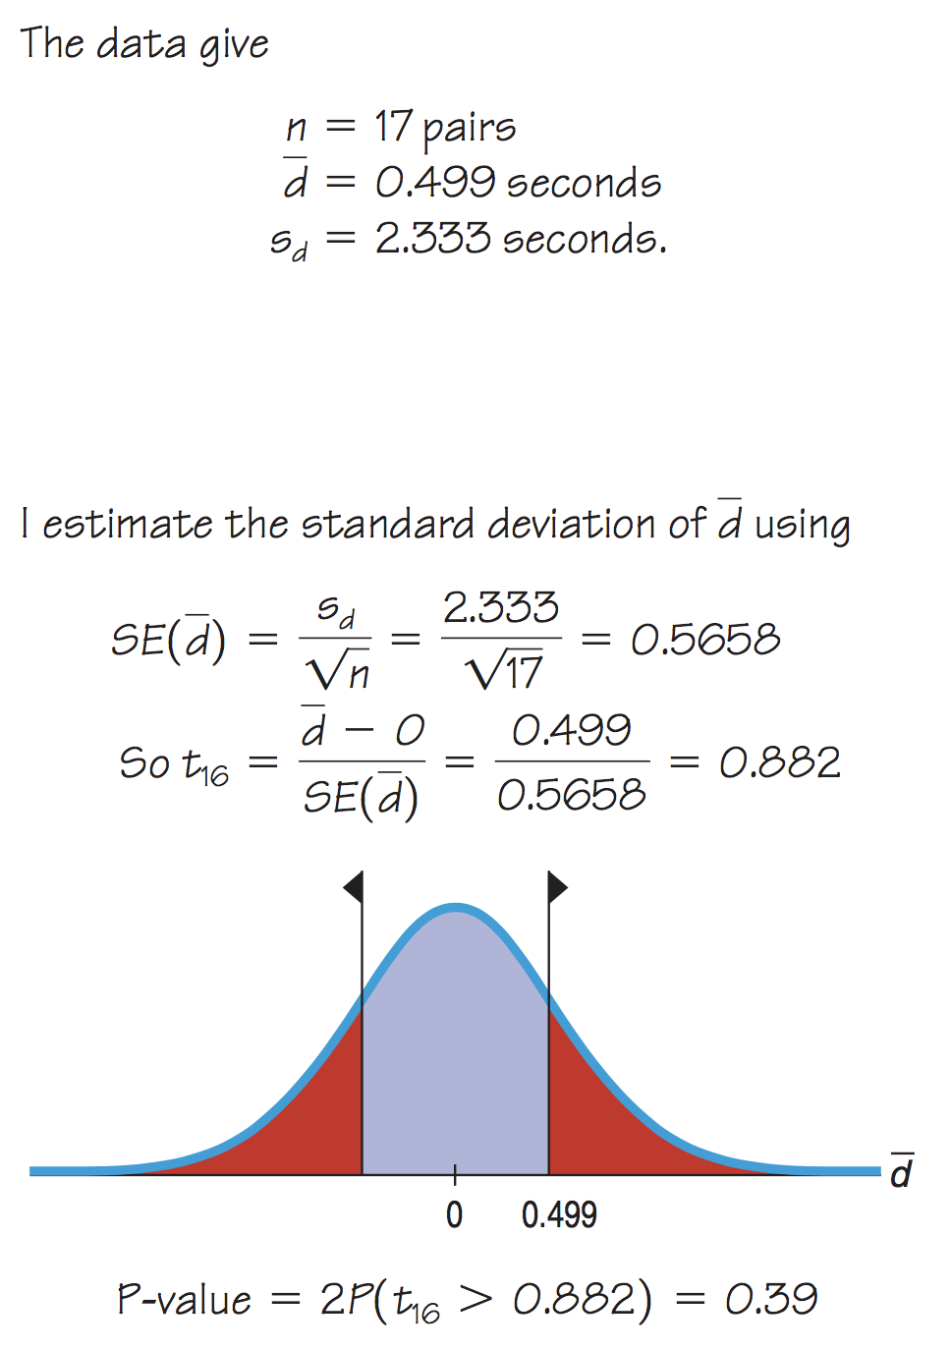
Lecture 20
Example of paired t-test: Speed skating
CHOONG-WAN WOO | COCOAN lab | http://cocoanlab.github.io

Slide 11
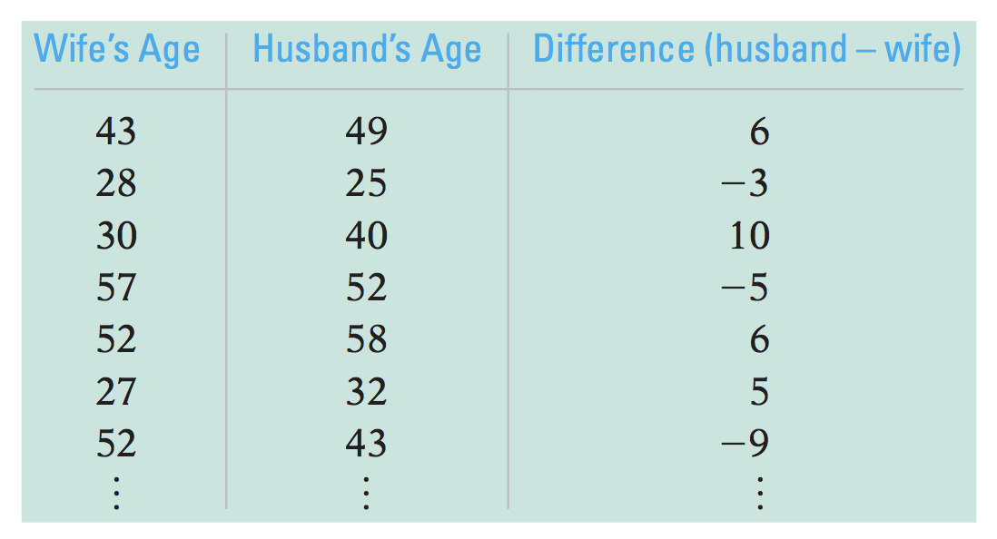
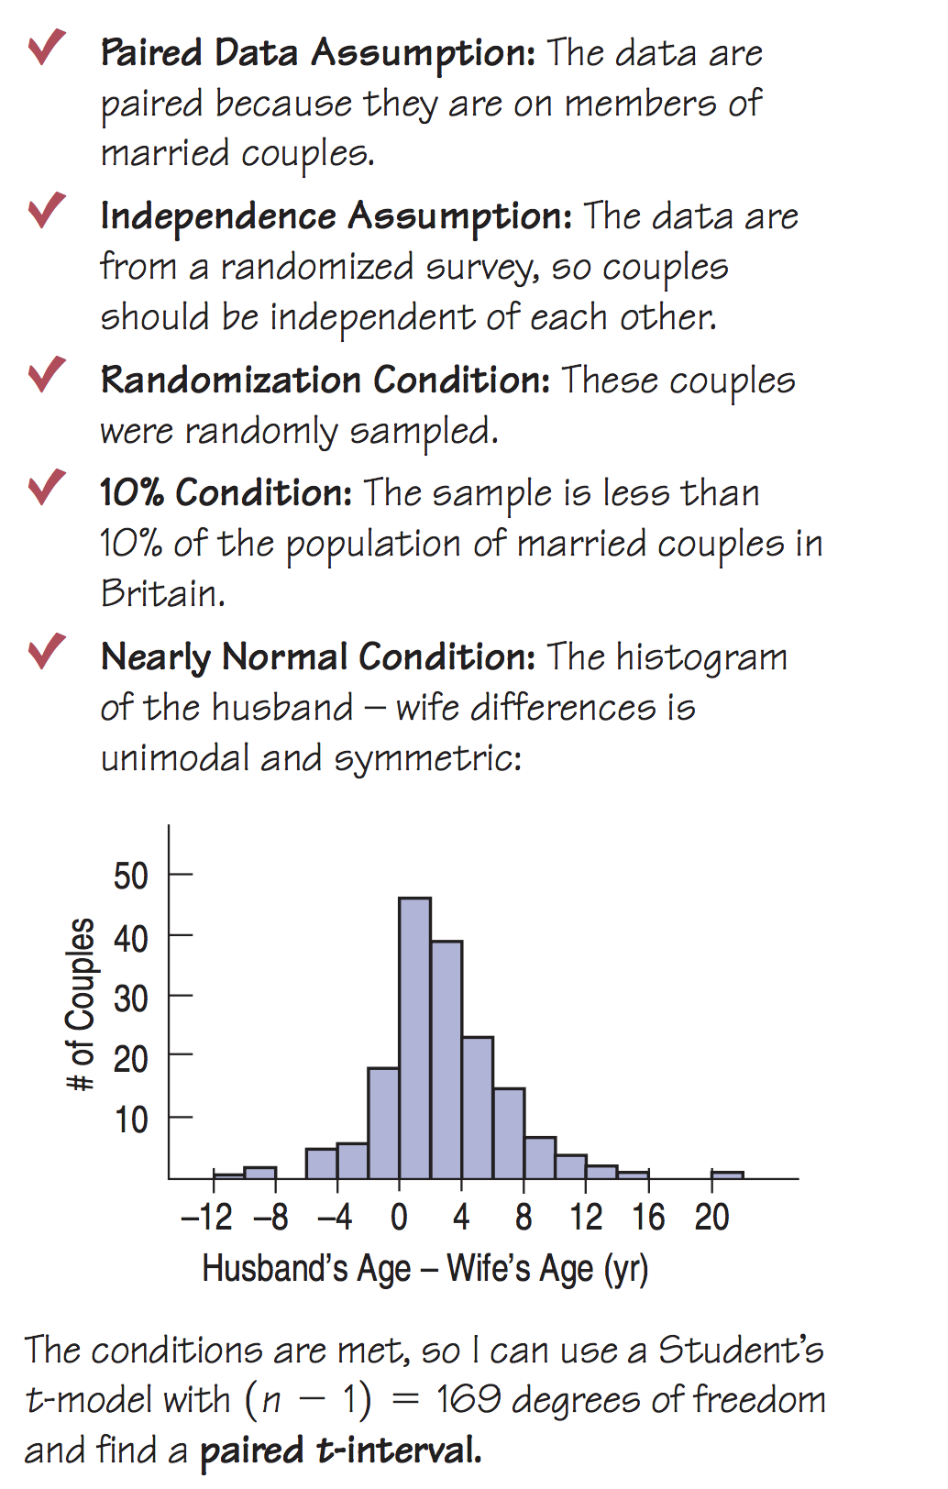
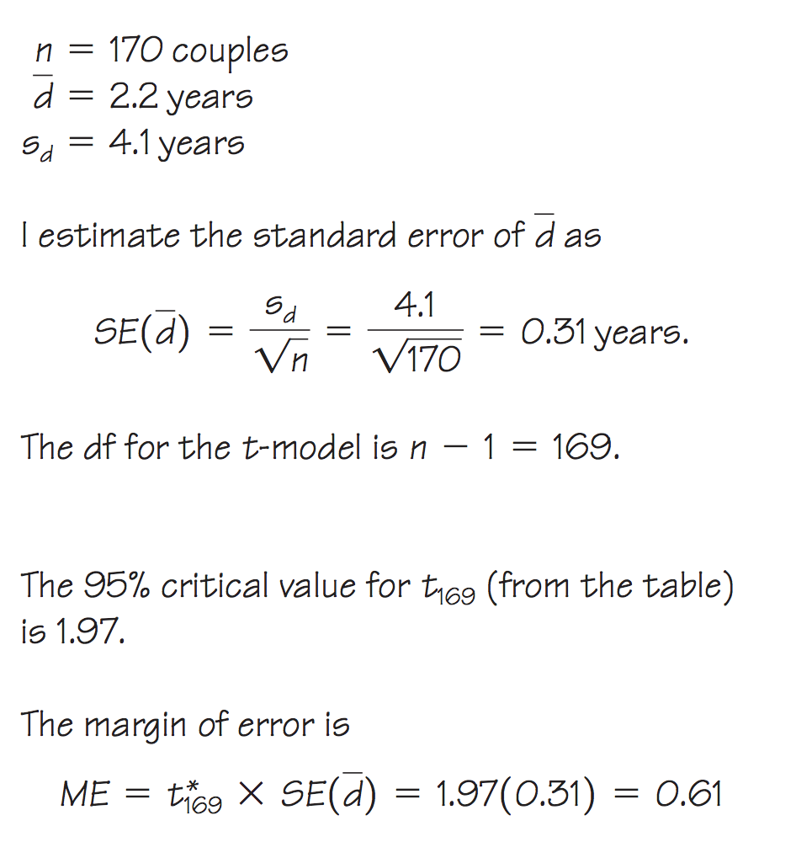
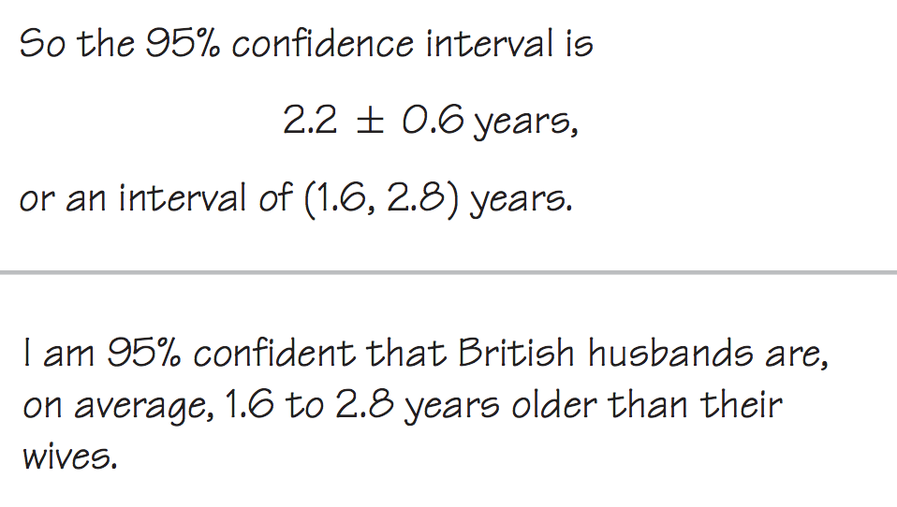
Lecture 20
Example of confidence intervals
Ages of husbands and wives
from 170 couples
CHOONG-WAN WOO | COCOAN lab | http://cocoanlab.github.io

Slide 12
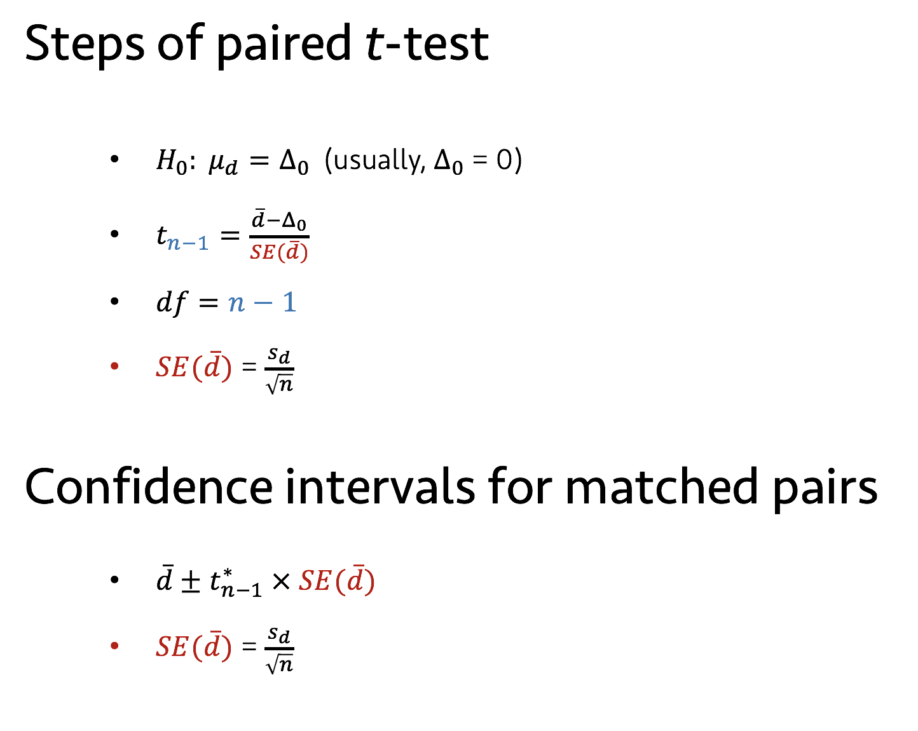
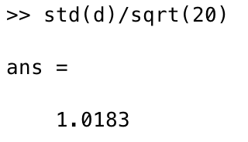
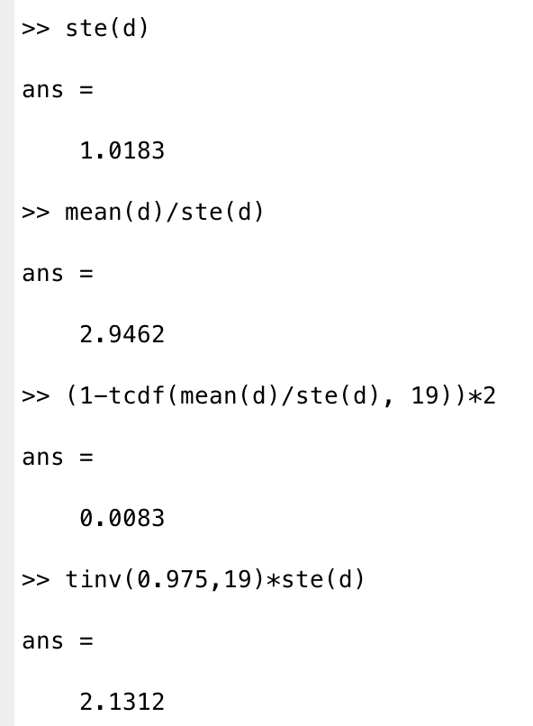
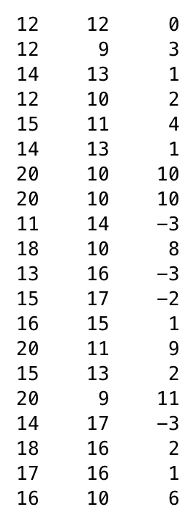
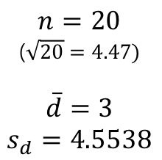
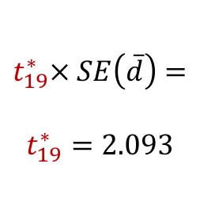
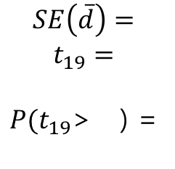
Lecture 20
Hands-on
x₁
x₂
x₁ – x₂
$$SE\left(\overline{d}\right)=$$
$$t_{19}=$$
$P(t_{19}$> ) =
$$t_{19}^{∗}× SE\left(\overline{d}\right)=$$
$$t_{19}^{∗}=2.093$$
$$n=20$$
($\sqrt{20}=4.47)$
$$\overline{d}=3$$
$$s_{d}=4.5538$$
CHOONG-WAN WOO | COCOAN lab | http://cocoanlab.github.io

Slide 13
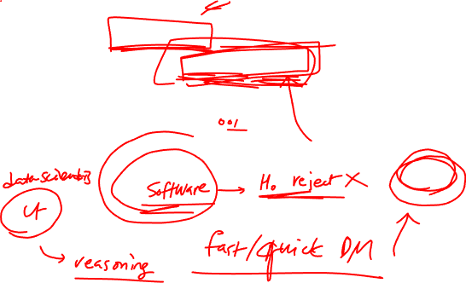
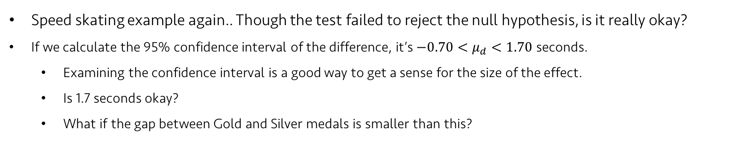
Lecture 20
Effect size
Speed skating example again.. Though the test failed to reject the null hypothesis, is it really okay?
If we calculate the 95% confidence interval of the difference, it’s $−0.70<μ_{d}<1.70$ seconds.
Examining the confidence interval is a good way to get a sense for the size of the effect.
Is 1.7 seconds okay?
What if the gap between Gold and Silver medals is smaller than this?
CHOONG-WAN WOO | COCOAN lab | http://cocoanlab.github.io

Slide 14
Lecture 20
Non-parametric test: Sign test
Distribution-free methods again!
For the pairs with negative differences, record 0’s
For the pairs with positive differences, record 1’s
Ignore the pairs with difference = 0
Then, test the associated proportion p = 0.5 using a z-test
CHOONG-WAN WOO | COCOAN lab | http://cocoanlab.github.io

Slide 15
Lecture 20
Quiz 20-2
https://forms.gle/XFYEzztuH9NomM2A6
CHOONG-WAN WOO | COCOAN lab | http://cocoanlab.github.io

Slide 16
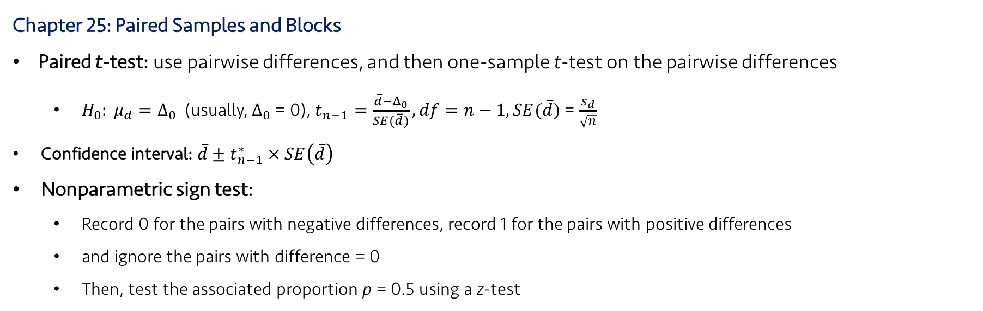
Lecture 20
Key Points
Chapter 25: Paired Samples and Blocks
Paired t-test: use pairwise differences, and then one-sample t-test on the pairwise differences
$H_{0}: μ_{d}=Δ_{0}$ (usually, $Δ_{0}$ = 0), $t_{n−1}=\frac{\overline{d}−Δ_{0}}{SE(\overline{d})}, df=n−1, SE(\overline{d})$ = $\frac{s_{d}}{\sqrt{n}}$
Confidence interval: $\overline{d}±t_{n−1}^{∗} × SE\left(\overline{d}\right)$
Nonparametric sign test:
Record 0 for the pairs with negative differences, record 1 for the pairs with positive differences
and ignore the pairs with difference = 0
Then, test the associated proportion p = 0.5 using a z-test
CHOONG-WAN WOO | COCOAN lab | http://cocoanlab.github.io

